Slide 1


Introduction to Git and GitHub
Fondren Library
Digital Scholarship Services

Slide 2

WHAT IS GIT?
The most widely used version-control system!
Remembers entire project history
Easily undo changes
Track contributions
Free and Open-Source Software
Fast & Simple
Optimized for collaboration
Non-linear development
9/29/2019
Digital Scholarship Services | Email cf24@rice.edu | library.rice.edu/dss
2

Slide 3
WHAT IS GIT NOT?
Affiliated with GitHub (which is owned by Microsoft)
A file editor
A graphical user interface
Many user interfaces exist
Proactive
Must tell git about everything we do!
9/29/2019
Digital Scholarship Services | Email cf24@rice.edu | library.rice.edu/dss
3

Slide 4


WHAT IS GITHUB?
The largest host for Git repositories
Free (for public repositories)
A great place to collaborate
Support for unique features
Comment sections
Organizations
Issue tracking
Extensible!
9/29/2019
Digital Scholarship Services | Email cf24@rice.edu | library.rice.edu/dss
4

Slide 5
WHAT IS GITHUB NOT?
The only option
GitLab, Bitbucket, …
A version-control system
Everything is on top of git
Only for source code and programming
Difficult!
9/29/2019
Digital Scholarship Services | Email cf24@rice.edu | library.rice.edu/dss
5

Slide 6
GITHUB &
GITHUB DESKTOP
A walkthrough of the user interfaces
9/29/2019
Digital Scholarship Services | Email cf24@rice.edu | library.rice.edu/dss
6

Slide 7
GETTING OUR BEARINGS: GITHUB.COM
9/29/2019
Digital Scholarship Services | Email cf24@rice.edu | library.rice.edu/dss
7

Slide 8
GETTING OUR BEARINGS: USER PAGE
9/29/2019
Digital Scholarship Services | Email cf24@rice.edu | library.rice.edu/dss
8

Slide 9
GETTING OUR BEARINGS: REPOSITORY
9/29/2019
Digital Scholarship Services | Email cf24@rice.edu | library.rice.edu/dss
9

Slide 10
GETTING OUR BEARINGS: DESKTOP
9/29/2019
Digital Scholarship Services | Email cf24@rice.edu | library.rice.edu/dss
10

Slide 11
STRUCTURE OF A GIT REPOSITORY
Snapshots, Locality, File States
9/29/2019
Digital Scholarship Services | Email cf24@rice.edu | library.rice.edu/dss
11

Slide 12
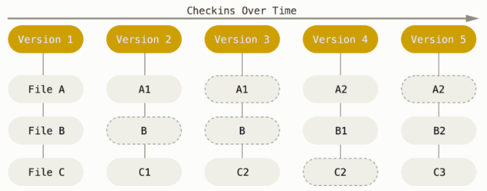
SNAPSHOTS
Stores the entire file structure at each snapshot, not a set of changes to one file!
9/29/2019
Digital Scholarship Services | Email cf24@rice.edu | library.rice.edu/dss
12

Slide 13
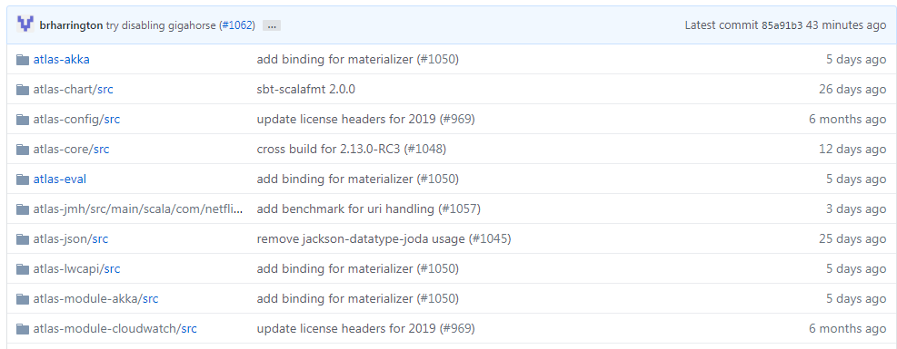
SNAPSHOTS
9/29/2019
Digital Scholarship Services | Email cf24@rice.edu | library.rice.edu/dss
13

Slide 14
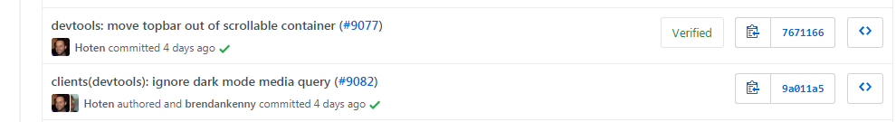
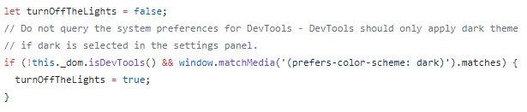

SNAPSHOTS
Sample Snapshot: Caption and Set of Files
Can see all files present at any of these times!
9/29/2019
Digital Scholarship Services | Email cf24@rice.edu | library.rice.edu/dss
14

Slide 15
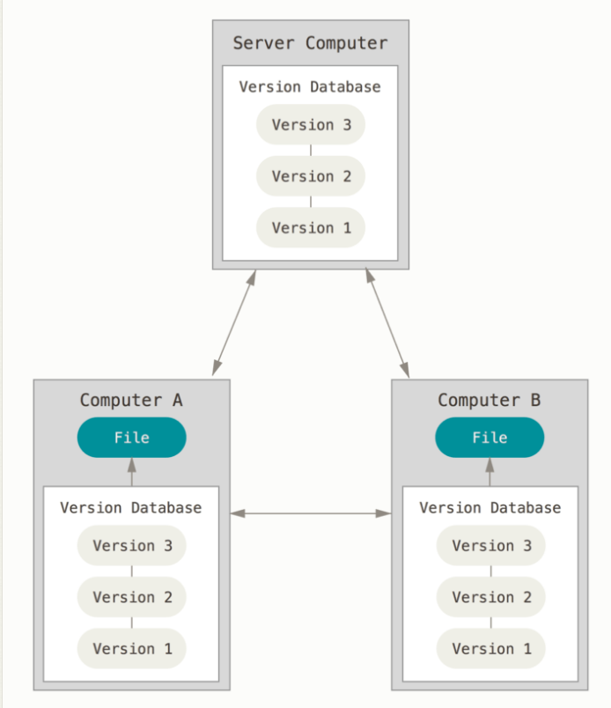
LOCALITY
Snapshots stored on your computer, not only on a server!
Hidden .git directory
Stores entire history of project (compressed!)
9/29/2019
Digital Scholarship Services | Email cf24@rice.edu | library.rice.edu/dss
15

Slide 16
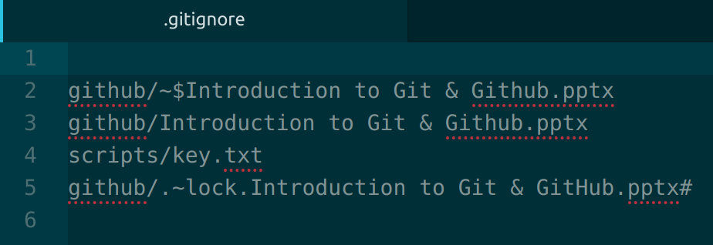
SPECIAL FILE: .GITIGNORE
.gitignore (note the period!)
A set of filenames.
No file in here will ever be tracked by git
Common Uses: backup and temporary files, stored passwords for APIs
9/29/2019
Digital Scholarship Services | Email cf24@rice.edu | library.rice.edu/dss
16

Slide 17
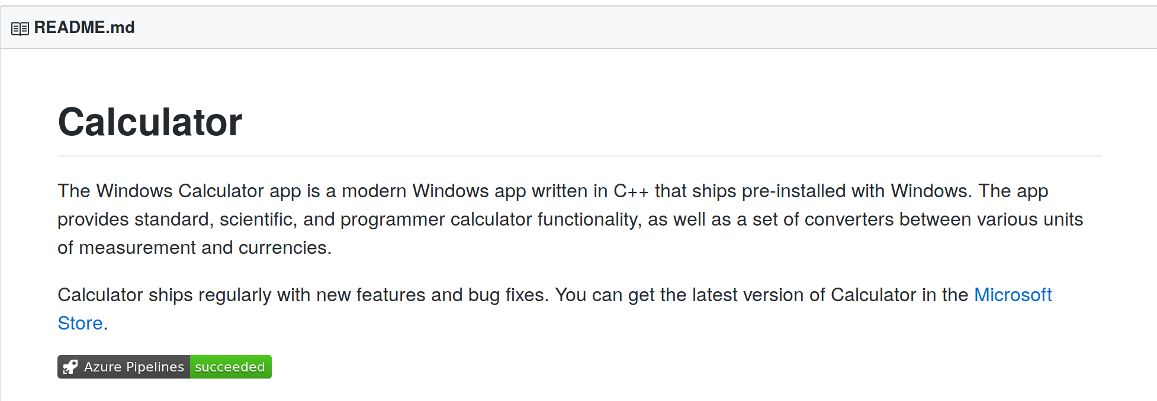
SPECIAL FILE: README.md
README.md (note the case!)
A text-based description of a directory or project
Uses Markdown language. Coming up next!
9/29/2019
Digital Scholarship Services | Email cf24@rice.edu | library.rice.edu/dss
17

Slide 18
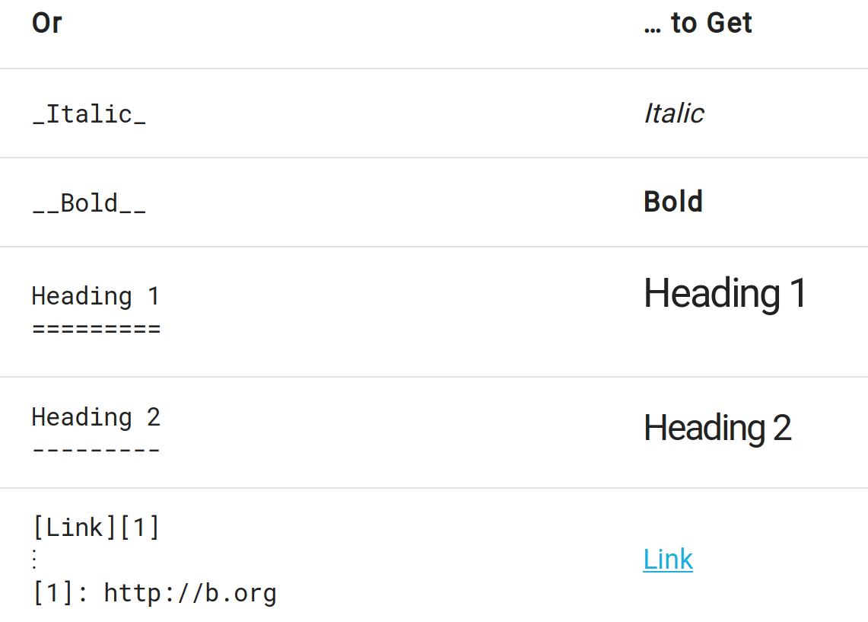
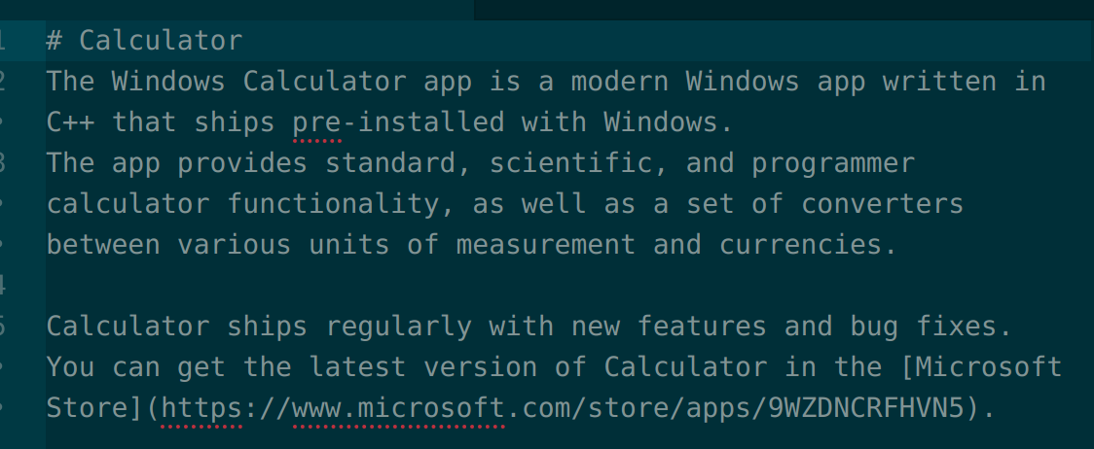
MARKDOWN
Simple formatting and text only
Many dialects
Used in a lot of places (Reddit)
9/29/2019
Digital Scholarship Services | Email cf24@rice.edu | library.rice.edu/dss
18

Slide 19
STATES OF FILES IN A REPOSITORY
untracked: git has not been told about this file.
modified: we told git about this file, but we've changed it without telling git to remember our change.
staged: we have told git about this file and told git we will want it to remember our change.
committed: we have made git take a snapshot of our file.
9/29/2019
Digital Scholarship Services | Email cf24@rice.edu | library.rice.edu/dss
19

Slide 20
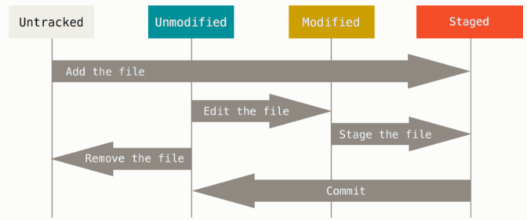
STATES OF FILES IN A REPOSITORY
9/29/2019
Digital Scholarship Services | Email cf24@rice.edu | library.rice.edu/dss
20

Slide 21
CREATING & CLONING REPOSITORIES
Initialization & Copying from a server
9/29/2019
Digital Scholarship Services | Email cf24@rice.edu | library.rice.edu/dss
21

Slide 22
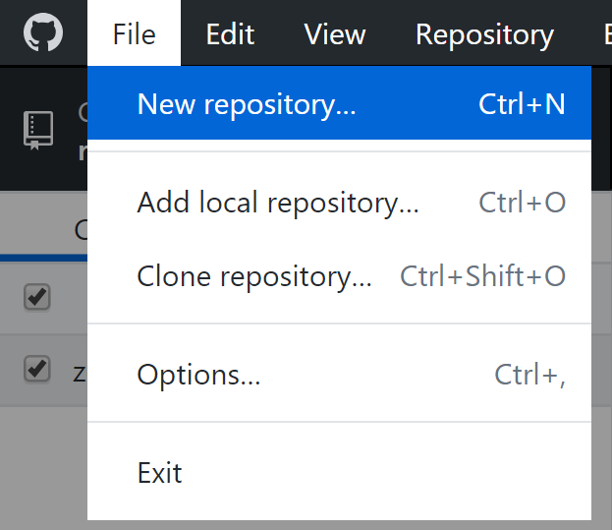
INITIALIZATION
Create a repository, with a file index and database
Stored in the hidden directory .git
Note: No files are added to the repository by default!
We’ll get to adding files a bit later
9/29/2019
Digital Scholarship Services | Email cf24@rice.edu | library.rice.edu/dss
22

Slide 23
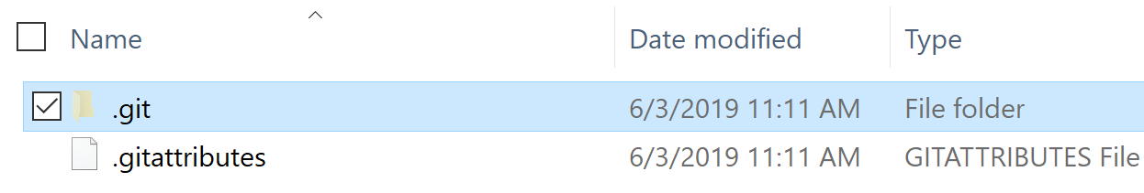
INITIALIZATION
Create a repository, with a file index and database
Stored in the hidden directory .git
Note: No files are added to the repository by default!
We’ll get to adding files a bit later
9/29/2019
Digital Scholarship Services | Email cf24@rice.edu | library.rice.edu/dss
23

Slide 24
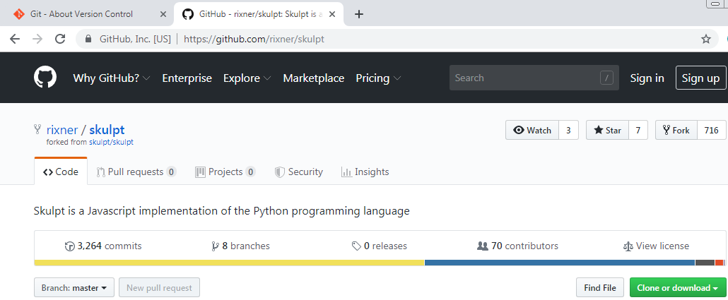
CLONING
Downloads entire history of a repository hosted on GitHub
Two ways to get the URL:
9/29/2019
Digital Scholarship Services | Email cf24@rice.edu | library.rice.edu/dss
24

Slide 25
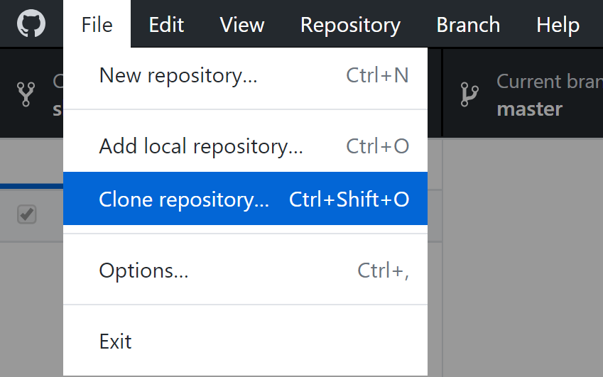
CLONING
Most recent snapshot immediately available
Full history needs to be downloaded as well. Takes time & space!
9/29/2019
Digital Scholarship Services | Email cf24@rice.edu | library.rice.edu/dss
25

Slide 26
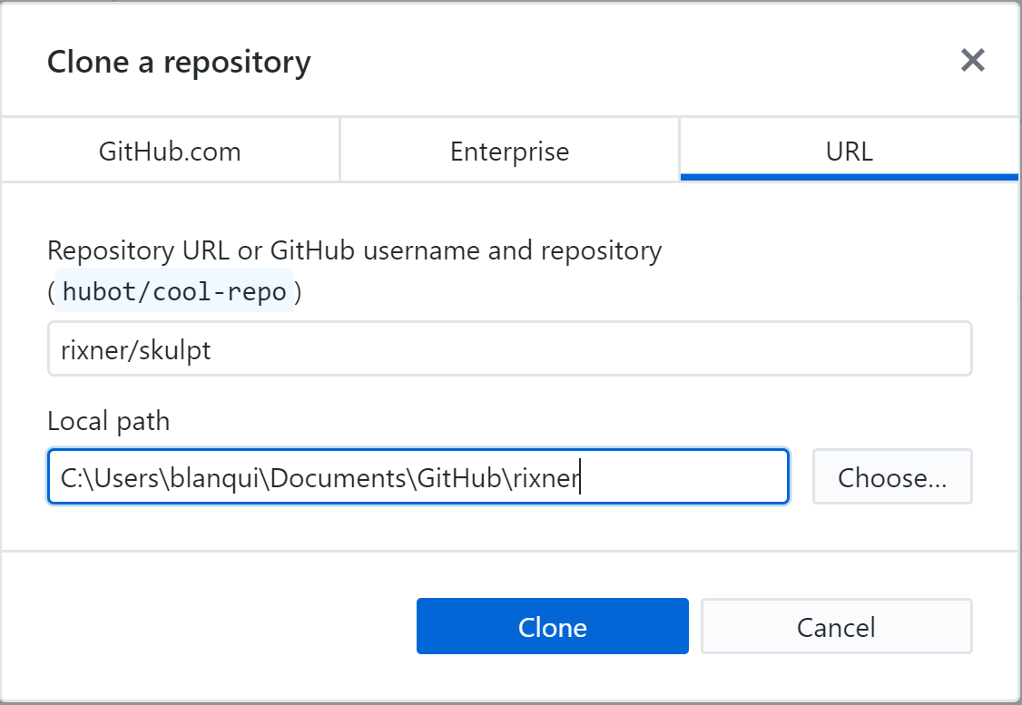
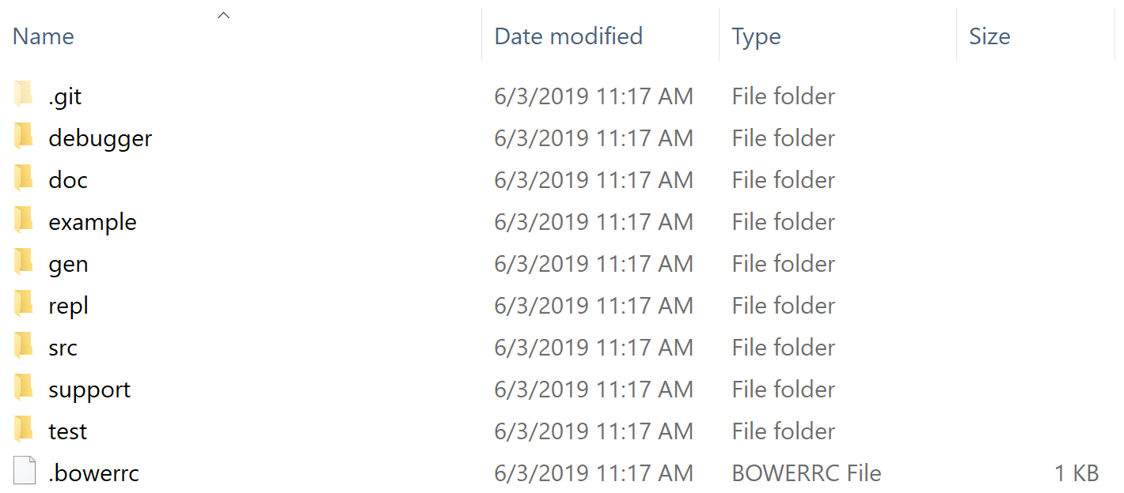
CLONING
9/29/2019
Digital Scholarship Services | Email cf24@rice.edu | library.rice.edu/dss
26

Slide 27
CLONING
Clone this repository from GitHub now!
https://github.com/bakitybacon/rice-data-and-donuts-github
9/29/2019
Digital Scholarship Services | Email cf24@rice.edu | library.rice.edu/dss
27

Slide 28
EDITING WORKFLOW
Editing, adding, staging, and committing
9/29/2019
Digital Scholarship Services | Email cf24@rice.edu | library.rice.edu/dss
28

Slide 29
REVIEW OF FILE STATES
9/29/2019
Digital Scholarship Services | Email cf24@rice.edu | library.rice.edu/dss
29

Slide 30
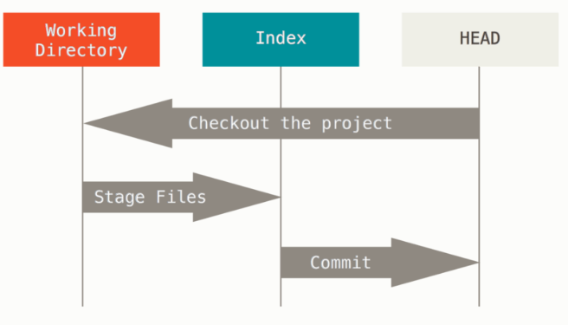
WORKFLOW
Working Directory
Changed files on disk.
Index
We’ve told git to pay attention to these changes.
HEAD
This is just the most recent commit (snapshot). You can come back here whenever!
9/29/2019
Digital Scholarship Services | Email cf24@rice.edu | library.rice.edu/dss
30

Slide 31
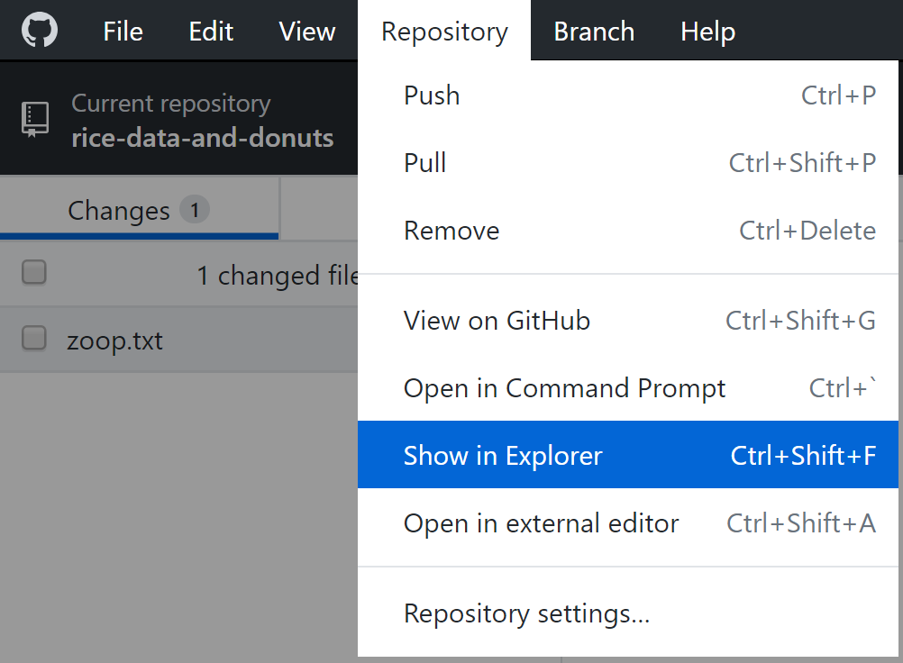
EDITING A FILE LOCALLY
Open and edit any file using any program
Use “Show in Explorer” to easily find the most recent files
9/29/2019
Digital Scholarship Services | Email cf24@rice.edu | library.rice.edu/dss
31

Slide 32
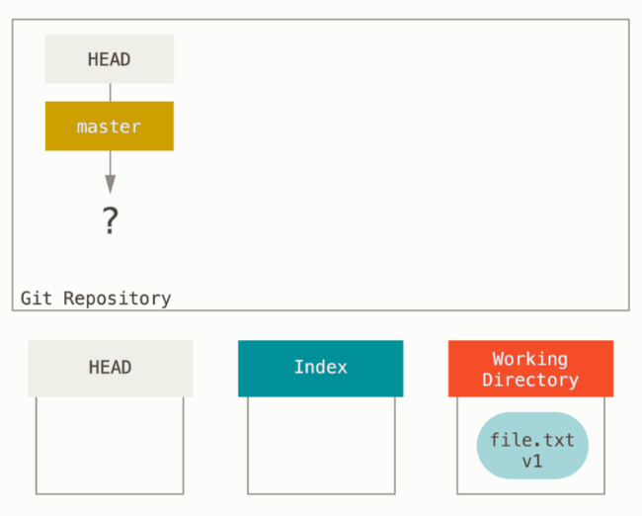
EDITING A FILE LOCALLY
Starting from an empty repository
How do we know?
HEAD doesn’t point to anything (no snapshots!)
We have edited a file in the Working Directory, but not yet told git to pay attention to it.
9/29/2019
Digital Scholarship Services | Email cf24@rice.edu | library.rice.edu/dss
32

Slide 33
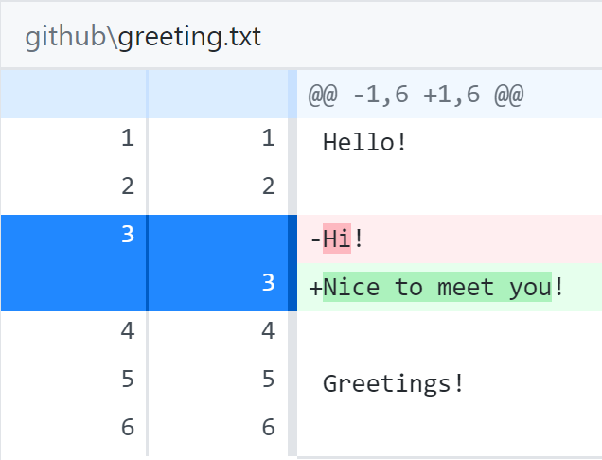
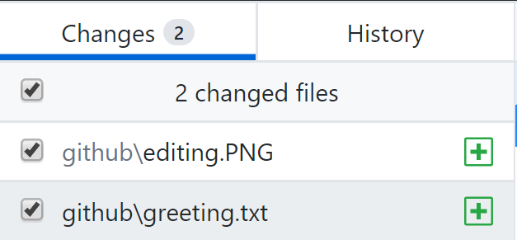
TELLING GIT ABOUT OUR CHANGES
Git will automatically find what we changed. All we have to do is tell it what we want to save
Toggle whether we want to add this change using check boxes
Monitor changes to text files
Green: added in
Red: taken out
White: not changed
9/29/2019
Digital Scholarship Services | Email cf24@rice.edu | library.rice.edu/dss
33

Slide 34
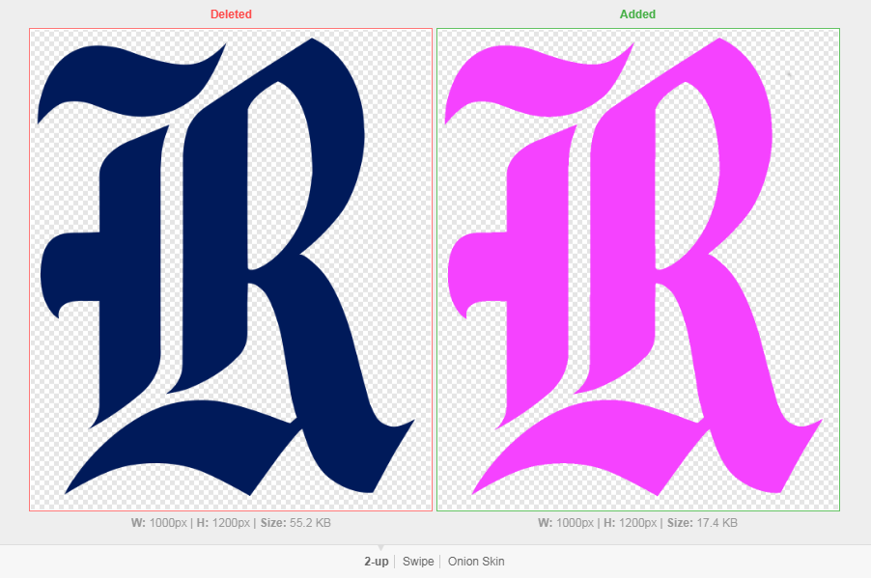
VIEWING CHANGES: IMAGES
2-Up: side-by-side
Swipe: left of divider is first image, right is second image
Onion Peel: images are overlaid, slider changes transparency setting
9/29/2019
Digital Scholarship Services | Email cf24@rice.edu | library.rice.edu/dss
34

Slide 35
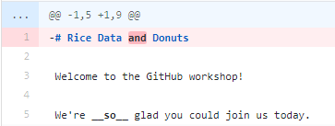
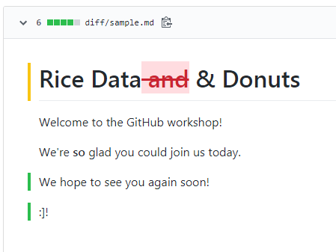
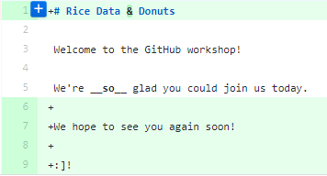
VIEWING CHANGES: DOCUMENTS
Prose Diff: see word-by-word changes in formatting
9/29/2019
Digital Scholarship Services | Email cf24@rice.edu | library.rice.edu/dss
35

Slide 36
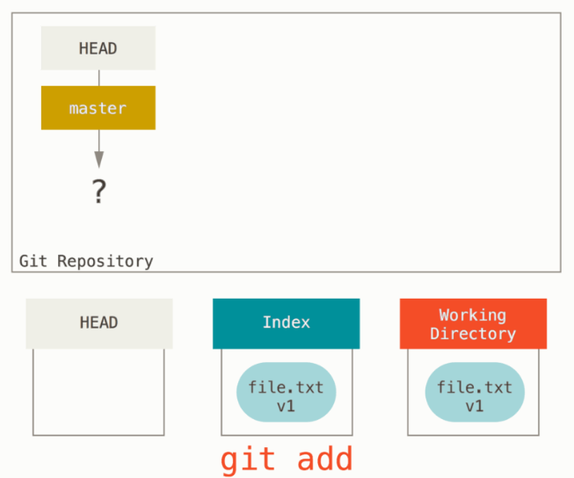
TELLING GIT ABOUT OUR CHANGES
Now that we have made file.txt, we can tell git to pay attention to the file
Transition between which two states for file.txt?
Command: git add
Whatever we have added will be changed in the new snapshot. No add means it won’t change!
9/29/2019
Digital Scholarship Services | Email cf24@rice.edu | library.rice.edu/dss
36

Slide 37
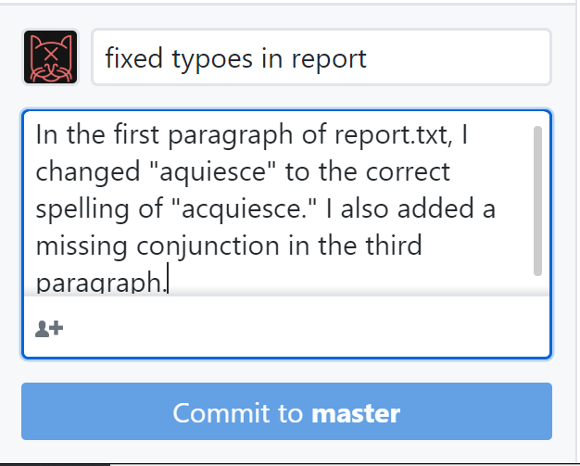
SNAPSHOTS OF OUR CHANGES
Once we have reached a milestone, or we just want to quickly and reversibly save our changes
Annotating our Snapshot
Short, simple summary. A few words
Extended description of approach. A few sentences
Only changes locally!
9/29/2019
Digital Scholarship Services | Email cf24@rice.edu | library.rice.edu/dss
37

Slide 38
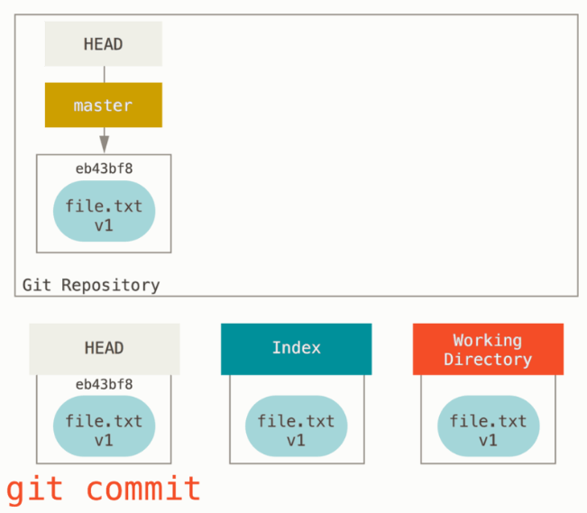
SNAPSHOTS OF OUR CHANGES
Tell git to take a snapshot of our files!
Transition between which two states for file.txt?
Command: git commit
HEAD now points to our most recent snapshot!
9/29/2019
Digital Scholarship Services | Email cf24@rice.edu | library.rice.edu/dss
38

Slide 39
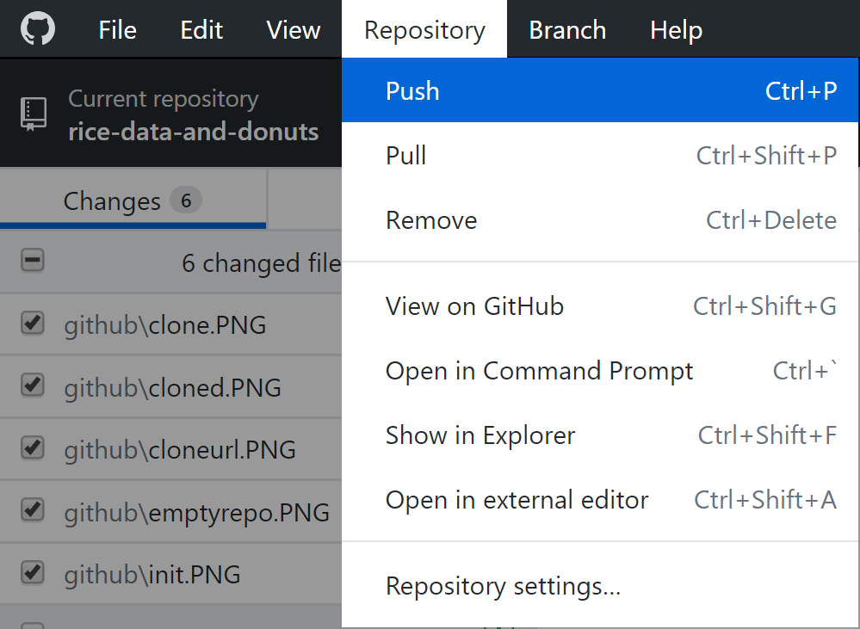
UPLOADING OUR CHANGES
Once we have a commit, we can send it to GitHub
This is called a push
Note: Changes are not sent to the server by default!
9/29/2019
Digital Scholarship Services | Email cf24@rice.edu | library.rice.edu/dss
39

Slide 40
UPLOADING OUR CHANGES
From the repository cloned earlier, upload a file with any message you like!
9/29/2019
Digital Scholarship Services | Email cf24@rice.edu | library.rice.edu/dss
40

Slide 41
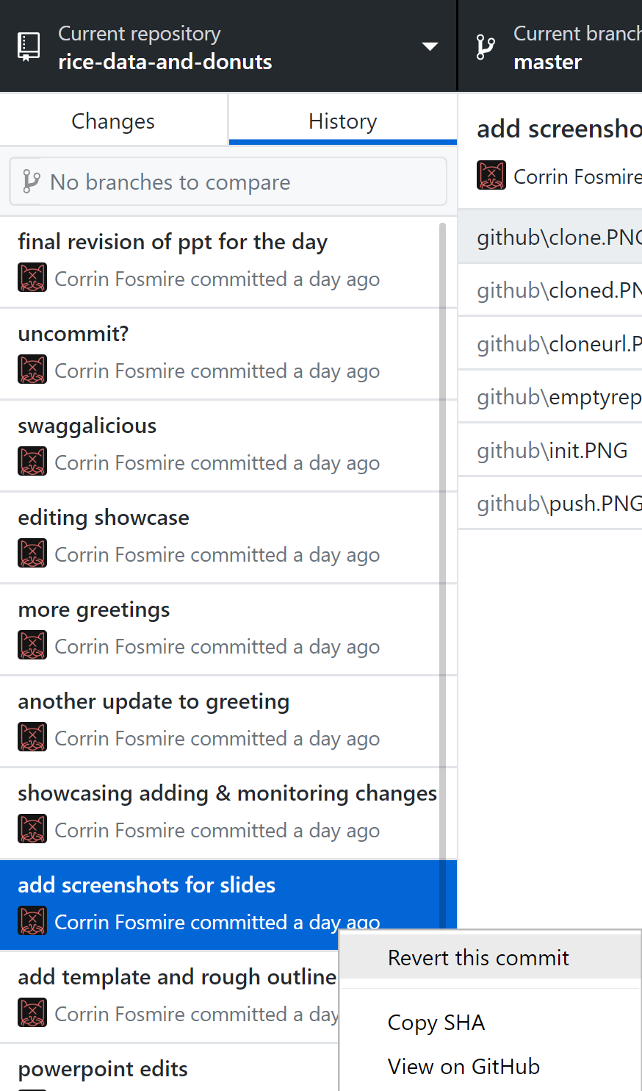
GOING BACK IN TIME
What if we accidentally made a change that deleted something we really needed?
Solution: Revert to a previous commit!
Note this doesn’t delete the changes after the revert
9/29/2019
Digital Scholarship Services | Email cf24@rice.edu | library.rice.edu/dss
41

Slide 42
GOING BACK IN TIME
Revert your message, then commit something different and push again!
9/29/2019
Digital Scholarship Services | Email cf24@rice.edu | library.rice.edu/dss
42

Slide 43
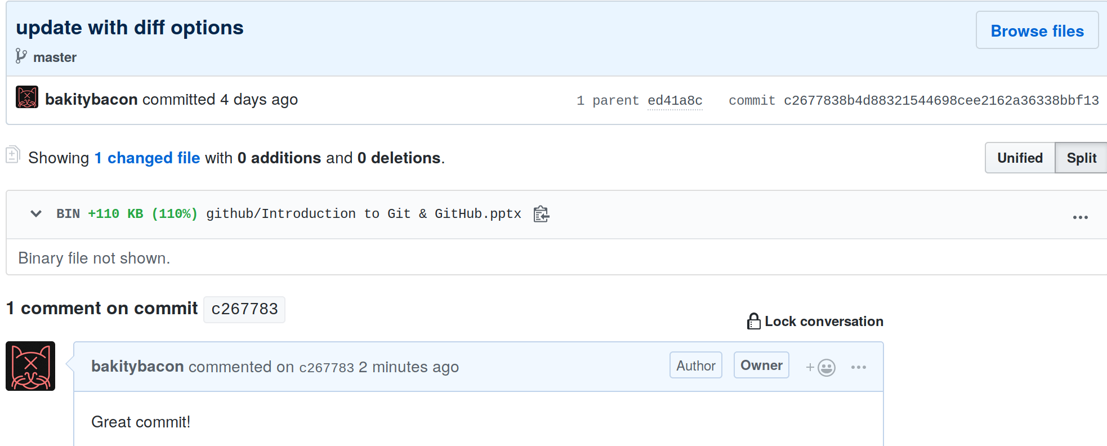
MAKING COMMENTS
GitHub allows us to write comments about a commit
Aids discussion of changes, hopefully productive arguments
History → Commits → Right Click → View on GitHub
9/29/2019
Digital Scholarship Services | Email cf24@rice.edu | library.rice.edu/dss
43

Slide 44
MAKING COMMENTS
Make a comment on either the revision or the original commit you made!
9/29/2019
Digital Scholarship Services | Email cf24@rice.edu | library.rice.edu/dss
44

Slide 45
BRANCHES & MERGING
Creating, working on, combining, and switching branches
9/29/2019
Digital Scholarship Services | Email cf24@rice.edu | library.rice.edu/dss
45

Slide 46
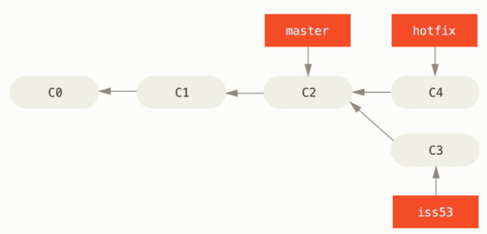
BRANCHES
If you’re working on different features or as part of a larger team
Divergent history
Independent files
Avoids unintended consequences!
Easy integration
9/29/2019
Digital Scholarship Services | Email cf24@rice.edu | library.rice.edu/dss
46

Slide 47
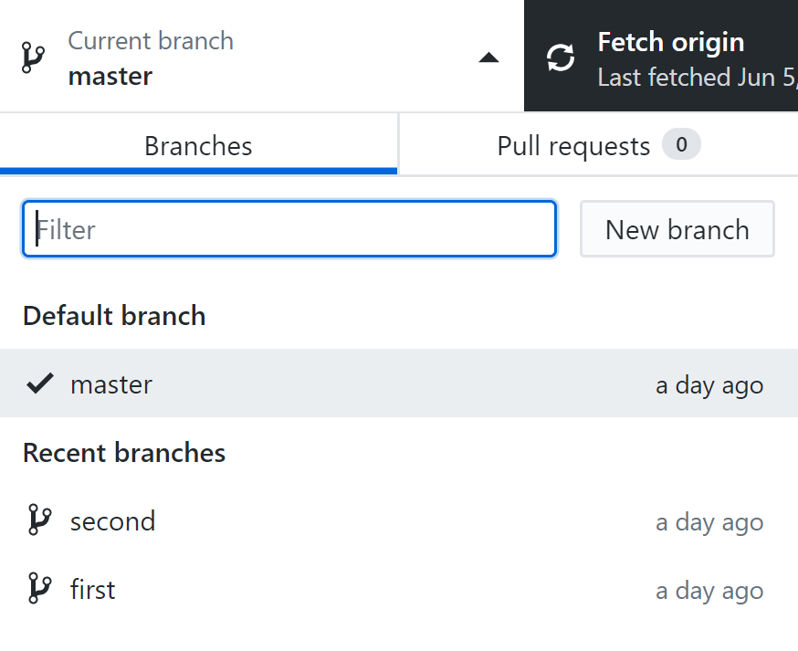
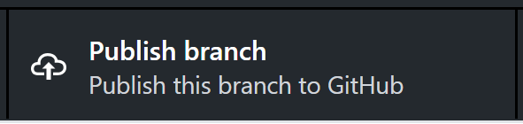
CREATING & SWITCHING BRANCHES
Click on the “Current branch” tab
If a branch isn’t listed, you may have to search for it
Make sure to publish the branch to GitHub!
9/29/2019
Digital Scholarship Services | Email cf24@rice.edu | library.rice.edu/dss
47

Slide 48
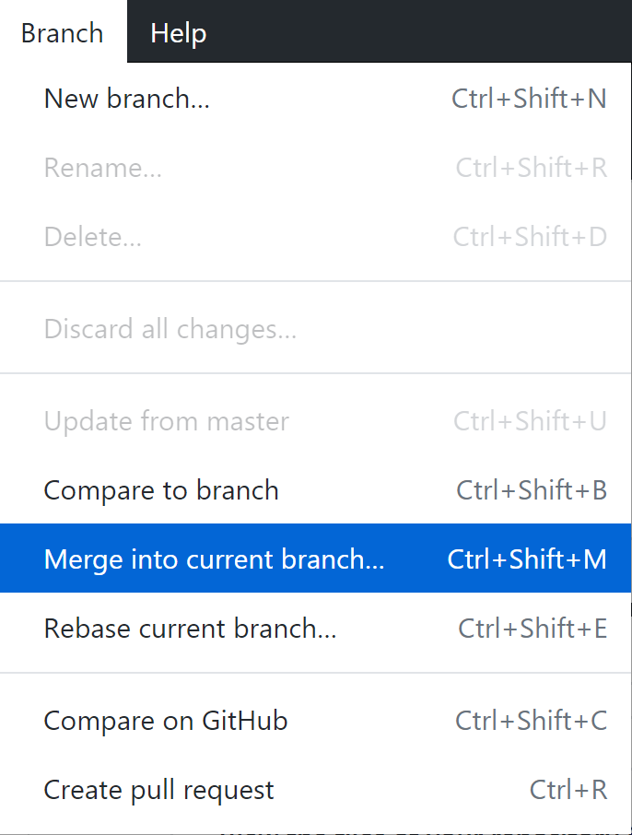
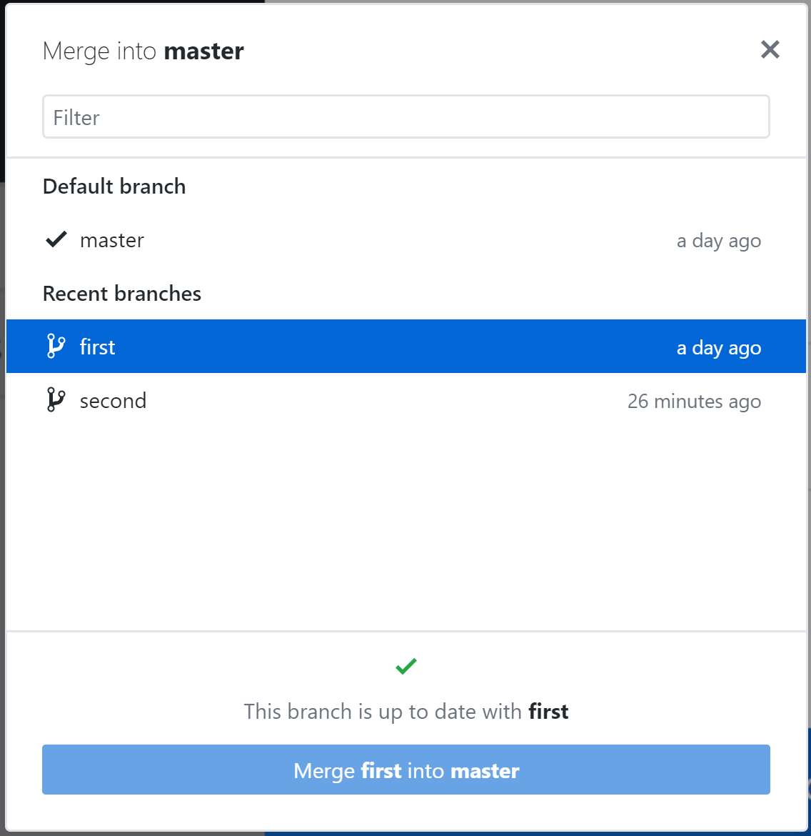
MERGING
Integrates changes that take place in a different branch
Usually goes smoothly if branches don’t overlap
9/29/2019
Digital Scholarship Services | Email cf24@rice.edu | library.rice.edu/dss
48

Slide 49
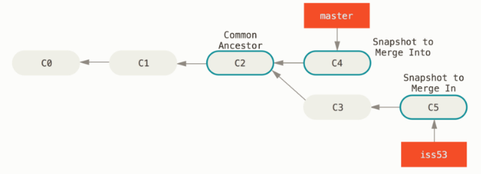
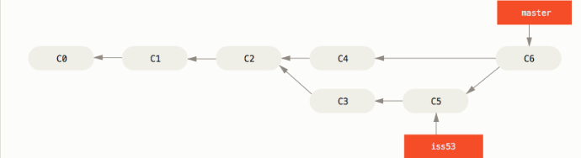
MERGING
9/29/2019
Digital Scholarship Services | Email cf24@rice.edu | library.rice.edu/dss
49

Slide 50
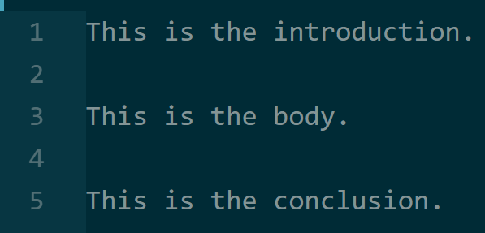
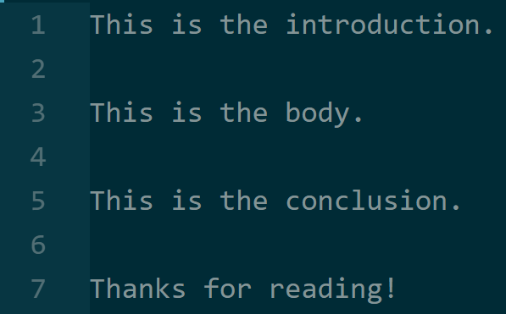
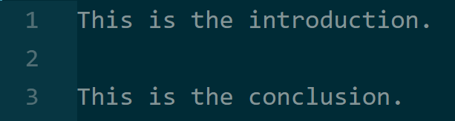
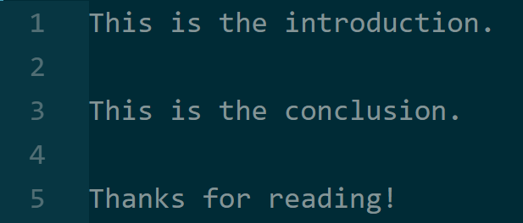
MERGING IN ACTION
Branch 1
(INTO)
Branch 1
(MERGED)
Branch 2
(IN)
9/29/2019
Digital Scholarship Services | Email cf24@rice.edu | library.rice.edu/dss
50

Slide 51
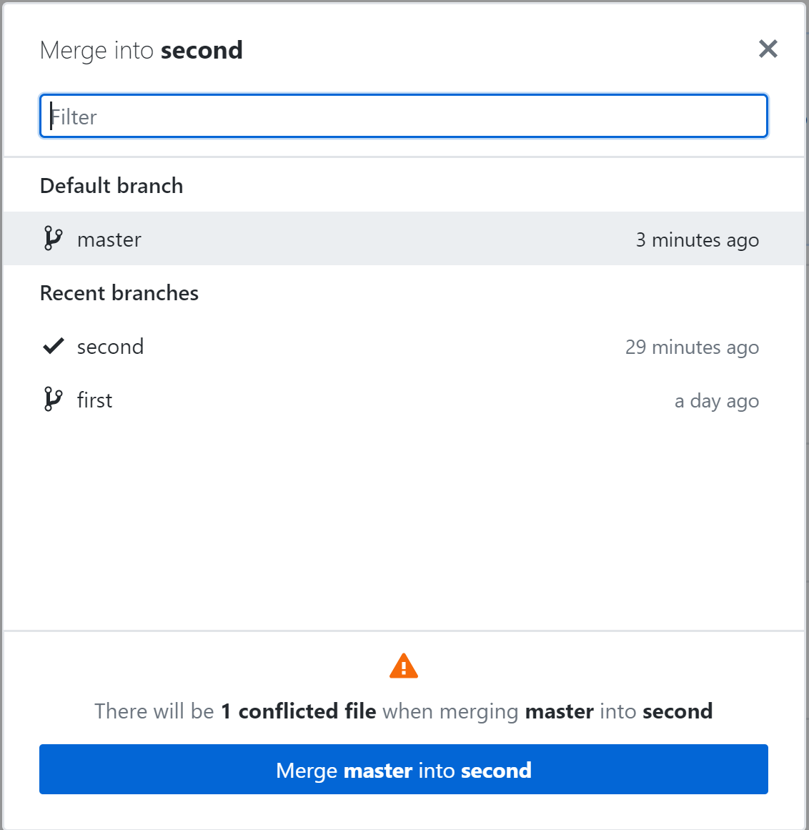
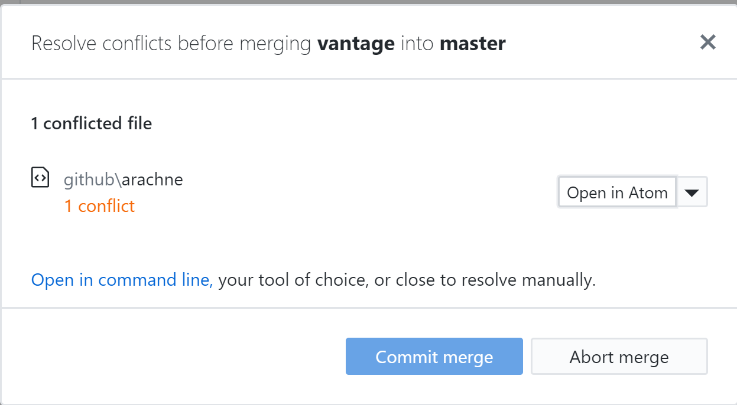
CONFLICTS
Occasionally, two people may have edited the same part of the same file on different branches
Which version do we take?
Must manually resolve conflicts
9/29/2019
Digital Scholarship Services | Email cf24@rice.edu | library.rice.edu/dss
51

Slide 52
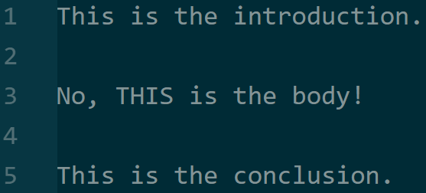
CONFLICTS IN ACTION
?
9/29/2019
Digital Scholarship Services | Email cf24@rice.edu | library.rice.edu/dss
52

Slide 53
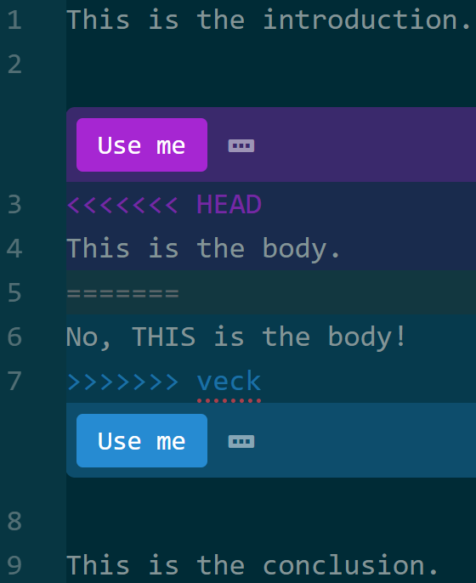
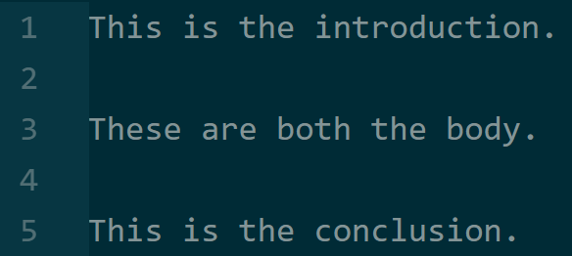
CONFLICTS IN ACTION
9/29/2019
Digital Scholarship Services | Email cf24@rice.edu | library.rice.edu/dss
53

Slide 54
CONFLICTS AND MERGING
Create a new branch.
Edit community.txt to include only a one-line message.
Try to merge it.
If it fails, merge by combining the two messages. Don’t delete anyone else’s work!
9/29/2019
Digital Scholarship Services | Email cf24@rice.edu | library.rice.edu/dss
54

Slide 55
COLLABORATING ON
GITHUB
Extensions to collaborate within teams, organizations, and more.
9/29/2019
Digital Scholarship Services | Email cf24@rice.edu | library.rice.edu/dss
55

Slide 56


GITHUB EXTENSIONS TO MERGING
Fork
Copy entire repository to your namespace
Gives edit privileges
Pull Request
Ask the repository owner to make a change
Can comment on and discuss with owner
9/29/2019
Digital Scholarship Services | Email cf24@rice.edu | library.rice.edu/dss
56

Slide 57
GITHUB EXTENSIONS TO MERGING
Fork https://github.com/bakitybacon/rice-data-and-donuts-github
Edit community.txt one more time
Make a pull request and comment on it!
9/29/2019
Digital Scholarship Services | Email cf24@rice.edu | library.rice.edu/dss
57

Slide 58
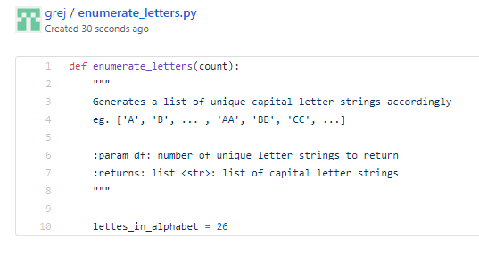
GISTS
Snippets of code, text, or anything.
Linked to your account, not a repository
Useful if you only have one file!
Shareable by URL (even in secret mode!)
9/29/2019
Digital Scholarship Services | Email cf24@rice.edu | library.rice.edu/dss
58

Slide 59


ORGANIZATIONS
In GitHub, a group of users and projects
Organizations can make repositories
Organization owner can manage permissions for all users
9/29/2019
Digital Scholarship Services | Email cf24@rice.edu | library.rice.edu/dss
59

Slide 60

TEAMS
Subset of an organization
Generally given an area of expertise (such as design) or a task
9/29/2019
Digital Scholarship Services | Email cf24@rice.edu | library.rice.edu/dss
60

Slide 61

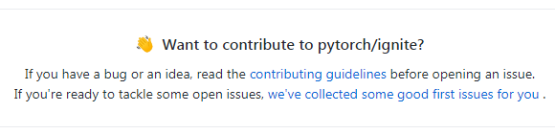
ISSUES
Pointing out what’s wrong
Hope someone can figure it out!
Even if they’re not the owner of the repository!
The benefit of open source
Great way to get involved
Supports discussions, fixes, etc
9/29/2019
Digital Scholarship Services | Email cf24@rice.edu | library.rice.edu/dss
61

Slide 62
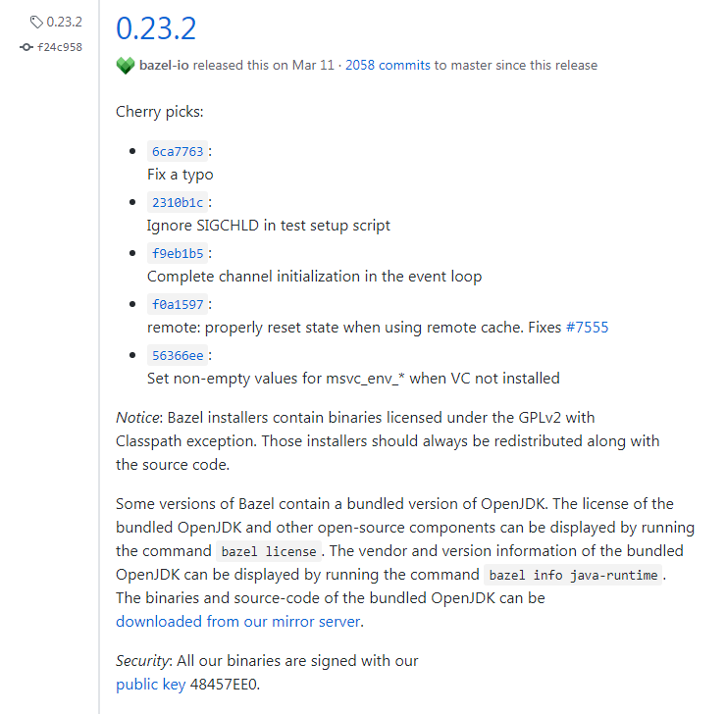
RELEASES
Basically just a tag for a commit
Can write a description
Markdown, again!
Link files (pdf of report, for example)
9/29/2019
Digital Scholarship Services | Email cf24@rice.edu | library.rice.edu/dss
62

Slide 63

PROJECTS
Tracking things to do
Individual or organizational scale
Can have issues, pull requests
Small informational cards
9/29/2019
Digital Scholarship Services | Email cf24@rice.edu | library.rice.edu/dss
63

Slide 64
DISTRIBUTED WORK
Paradigms for getting the most out of working as a team
9/29/2019
Digital Scholarship Services | Email cf24@rice.edu | library.rice.edu/dss
64

Slide 65

BRANCHING WORKFLOWS
Not technically distributed
Try a lot of things out on separate branches & merge!
Can work on many problems at the same time
9/29/2019
Digital Scholarship Services | Email cf24@rice.edu | library.rice.edu/dss
65

Slide 66

CENTRALIZED WORKFLOW
Everyone is equal
Leverages branches
Everyone must merge their own work!
What if you don’t like how someone else merged?
No overhead from dedicated integration manager
9/29/2019
Digital Scholarship Services | Email cf24@rice.edu | library.rice.edu/dss
66

Slide 67

INTEGRATION MANAGER WORKFLOW
Developers have copies of the “blessed” repository
They make changes, then ask integration manager to incorporate them
More overhead
More accountability
9/29/2019
Digital Scholarship Services | Email cf24@rice.edu | library.rice.edu/dss
67

Slide 68

INTEGRATION MANAGER WORKFLOW IN GITHUB
You can see this workflow in GitHub all the time
Fork/Merge & Pull Request:
Make a copy of a repository
Make a change
Ask the original repository’s owner to “pull” your change into his project
9/29/2019
Digital Scholarship Services | Email cf24@rice.edu | library.rice.edu/dss
68

Slide 69

LIEUTENANT & DICTATOR WORKFLOW
Essentially the same as integration manager with one more layer to go through
More overhead, but can use expertise effectively
Lieutenant 1 expert in programming, Lieutenant 2 in design, for example
9/29/2019
Digital Scholarship Services | Email cf24@rice.edu | library.rice.edu/dss
69

Slide 70
ACKNOWLEDGMENTS
The figures are taken from Pro Git book, written by Scott Chacon and Ben Straub and published by Apress, used under the terms of the Creative Commons Attribution-NonCommercial-ShareAlike 3.0 Unported License.
The GitHub Mark and Octocat are used under their official license (https://github.com/logos)
The Git logo is used under the Creative Commons Attribution 3.0 Unported License.
Screenshots are taken from GitHub Desktop and Atom.
9/29/2019
Digital Scholarship Services | Email cf24@rice.edu | library.rice.edu/dss
70

Slide 71
ABOUT RESEARCH DATA SERVICES
Data @ Rice Workshops on Python, R, Excel, and many more
Consulting on managing data, acquiring data, use of R, Python, SPSS, Excel, and more
Review draft data management plans
Teach custom workshops on request
Data Office Hours
Prefer a one-on-one consultation? Drop by our office hours 3:00 p.m.-4:00 p.m. on Tuesdays or 12:30-1:30 p.m. on Thursdays in the GIS-Data Center classroom (basement of Fondren Library), or schedule an appointment at https://library.rice.edu/data-assistance.
9/29/2019
Digital Scholarship Services | Email cf24@rice.edu | library.rice.edu/dss
71

